Slide 1
Welcome to Parent Information Night
First Grade
2016-2017

Slide 2
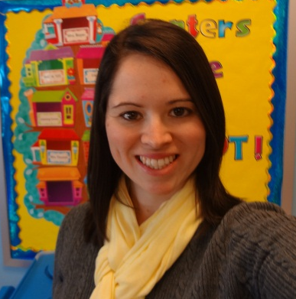
Introductions
Mrs. Amanda Boyer
Sixth Year at SJS and Fifth Year in First Grade
BA in Sociology from EIU and MA in Elementary Education from Lewis University
“ I love working with First Graders because they see the world in unique ways. They also have so much enthusiasm for new ideas and activities which keeps each day lively, exciting, and new.”

Slide 3
Classroom Expectations
Follow Classroom and School Rules
  Individual Behavior Plan
    ClassDojo
      Point System
      Parents can monitor in real-time and message with the teacher.
    Color Chart
      Purple, Blue, Green, Yellow, and Red
        2 warnings before moved down.
  Whole Class Behavior Plan
    Warm Fuzzy Jar
      More than 100 points for the class a day =
      a warm fuzzy

Slide 4
Important Information
Student of the Week
  Packet and Poster
  Guest Reader
Birthdays
  Celebrate with a snack from the SJS approved list (no frozen treats)
Scholastic Reading Club
  Book order forms and code

Slide 5
Homework
Read for 15-20 minutes every night
  Calendar
Words Their Way sort activities Monday – Thursday
  Back of Calendar
Math on Tuesday and Wednesday to review skills
STUDY – Thursday night
  Simple Solutions
  Words Their Way
  Word Wall Words

Slide 6
First Grade Schedule
Lunch and Recess: 12:30-1:10
Snack: Daily in the Mornings
Music on Monday
Library on Tuesday
PE on Wednesday
Mass and PE on Friday

Slide 7
ELA Curriculum
Reader’s Workshop:
  Develop fluency, comprehension and vocabulary
  Learn how to reflect, analyze and discuss across all genres of literature
  Work will be kept in a binder
  Writing
  Throughout the curriculum
  Direct instruction begins in January
      Narrative
      Informational
      Persuasive
      Poetry

Slide 8
ELA Curriculum Cont’d
Language:
  Parts of Speech
  Sentence Structure
  Daily Language in January
Phonics:
  Long and Short Vowel Patterns
  Blends and Diagraphs
  Initial, medial, and final sounds
  Compound Words
  Syllables
  Word Wall (High Frequency Words)
  4 words a week
  Tested on Fridays

Slide 9
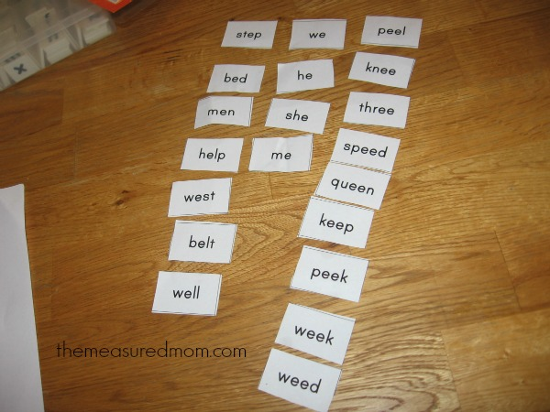
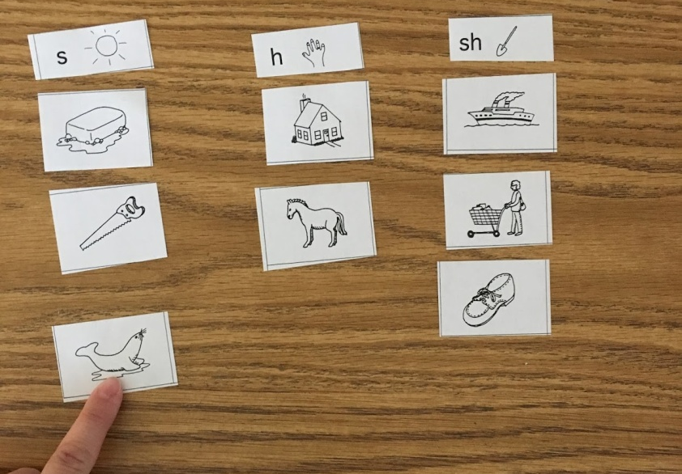
ELA Curriculum Cont’d
Word Study: (Words Their Way and Word Wall)
  Hands on sorting based on spelling patterns
  Individual Pacing
  Picture and Word Sorting
  Assessed on Fridays
    Recognizing patterns in new words
    Spelling
    Application

Slide 10
WTW Homework
Monday – Practice Sort
Tuesday and Wednesday - Word Hunt
Thursday – Study for Friday’s Test

Slide 11
Math Curriculum
  - Daily Practice and instruction towards mastery of concepts
    Addition and Subtraction
    Fact Families
    Telling Time
    Reading a Calendar
    Fractions
    Geometry
    Measurement
  Manipulative use and
  technology

Slide 12
Science and Social Studies
Curriculum
Science:
  Presented through informational nonfiction materials
  Hands-on experiments using Scientific Method
    Science Lab
Social Studies:
  Focus on the United States and what makes our country unique
  Past, present, and future events and people
  Geography
  Holidays
  Election

Slide 13
Religion and Social
Religion
    Explore life of Jesus through Gospel and classroom activities
    Prayer
    Recognize their special place in God’s Family
Social Development
  Second Step
    Hands on activities for Social and
    academic success
    Skills for learning, self-regulation,
    Empathy, emotion management, etc.

Slide 14
Grading Policy
Grade | Description
M – Mastered | Consistently Demonstrates
S – Successful | Frequently Demonstrates
E – Emerging | Occasionally Demonstrates
N – Not Yet | Rarely/ Never Demonstrates

Slide 15
What can you do to help?
Encourage your child to read daily
Check email frequently for communication
Read through the weekly newsletter
Do not hesitate to contact me with concerns or questions
Donate old books to keep our classroom library new and interesting

Slide 16
Contact Information
Mrs. Amanda Boyer
  aboyer@stjamesschoolah.org
Classroom Website
  http://boyerfirstgrade.weebly.com/

